Slide 1
Introduction to Trident

Slide 2
Introduction to Trident - Agenda
Trident Overview:
  What is it?
  Why is it?
Application interface
  What’s new
  What’s the same
New Features in the working
VeriFone Confidential

Slide 3
Trident Porting
Trident Overview:
  Uses a 32-bit ARM1136J-S SOC
  Designed to achieve 400MHz clock speed
  Application runs in SDRAM
  No battery backed RAM, information are now stored in FLASH
  More secure than all previous Vx terminals
  Currently two models are in the works:
    Vx680: 64MB SDRAM, 128MB FLASH
    Vx520: 32MB SDRAM, 128MB FLASH
VeriFone Confidential

Slide 4
Application Development
Rules for All Trident Platforms:
Must use RVDS 4.0
Must use –b link option
Recommend SDK 3.3.0B ECO or later
For Production release - Must acquire new certificates and signer cards
Default certificate is no longer supported
VeriFone Confidential

Slide 5
Application Development
Rules for All Platforms:
Application can read and write removable external FLASH device – USB, SD if available
VeriFone Confidential

Slide 6
Application Development
Updating OS for Trident platform:
Two key files must be loaded into the terminal:
  pssbi.scr
  vxped.bin
  sbi.bin (Depending on OS package if there’s an SBI update)
Updating method – using a USB flash drive or a micro SD card, memory size 2 GB max.
Vx520
  A USB flash drive with max size 2GB and FAT16
  Serial can be used if SBI version is 2.6 or higher
Vx680
  Vx680 – Can only be used serial
Insert the proper device into the terminal while powered off. Power on the terminal and wait for the update to complete
VeriFone Confidential

Slide 7
Application Development
Updating OS for Trident platform: (cont.)
Run the proper batch file to set the environment variables to proper values:
  Vx520.bat and vx680.bat
  *VTYPE = 520 or 680
  *PRTYPE= 88
Current default system password 12345
Latest OS version
  Vx520 - QT52E20P, good for EVT-2 units
  Vx680 – QT68E20Q, cannot be loaded into a Vx680 EVT-2
VeriFone Confidential

Slide 8
Application Interface
Vx520
Same display as Vx510
Same keyboard as Vx510
Same Function and Screen keys as Vx510
Same Comm ports as Vx510
Same Printer Interface as Vx510
Conexant “Harley” Modem
Ethernet
Larger Memory
Added USB Host
VeriFone Confidential

Slide 9
Application Interface
Vx520 – Ethernet setup
MAC address setup:
  To make the Ethernet connection work we have to define the MAC Address first, we have to set the *ETHMAC system variable to its proper value. The values can be seen from the file “macadd.txt” included in this package. Just refer to the to the sequence number (white label on the left side of the terminal).
  Example:
  A terminal with S/N of “1-001” should have it set as:
  “*ETHMAC=B4F0033C6”
VeriFone Confidential

Slide 10
Application Interface
Vx680
Color Graphic Display
Touch Screen
No Function and Screen keys
Compatibility Mode – provides automatic soft Function and Screen keys
Same Comm ports as Vx670
Same Printer Interface as Vx670
Larger Memory
VeriFone Confidential

Slide 11
Application Interface
Vx680 - display
240x320 pixels color graphic display
Supports current screen APIs enhanced for color
Adds raw display buffer interface
See OS ERS and SVC.H and SVC_SWI.C
VeriFone Confidential

Slide 12
Application Interface
Vx680 - display
New API
  int set_backlight_level (int value);
  int put_BMP_at ( int x, int y, char *file);
  int display_frame_buffer(int x, int y, int w, int h, short * buffer);
  int SVC_INFO_DISPLAY_EXT(displayInfo_t * info);
  // Display Information data structure for the function SVC_INFO_DISPLAY_EXT()
  // NOTE: structure is duplicated in SYS.H
  typedef struct {
  char moduleName[20];
  char controllerName[20];
  int driverVersion; // ie. version 2.52.142 = 0x00 02 34 8E
  int width;
  int height;
  int bitsPerPixel;
  int pixelFormat;
  } displayInfo_t;
VeriFone Confidential

Slide 13
Application Interface
Vx680 - display
Changed API
int get_display_color(int type)
FOREGROUND_COLOR
  0 = WHITE (monochrome and 4 level gray only)
  1 = BLACK (monochrome and 4 level gray only)
  2 = LIGHTGRAY (4 level gray only)
  3 = DARKGRAY (4 level gray only)
  16 bit RGB value (RGB mode only)
BACKGROUND_COLOR
  Same as FOREGROUND_COLOR
CURRENT_PALETTE
  This is the currently selected palette
  1= RGB
  2 = MONOCHROME (black and white)
  4 = GRAY4 (4 level gray scale)
AVAILABLE_PALETTE
  1, monochrome only (510, 570, 610)
  2, monochrome and 4 level gray (670)
  3, RGB (580, 680)
VeriFone Confidential

Slide 14
Application Interface
Vx680 - display
Changed API
int get_display_color(int type)
The 16-bit RGB is formatted as 5:6:5.
That is 5 bits for RED, 6 bits for GREEN and 5 bits for BLUE.
For example:
RED fully on will be 0xF800.
PURPLE will be 0xF81F.
This format also applies to the following APIs and any API where the user may specify the color.
i.e. int write_pixels (int startX, int startY, int endX, int endY, int color)
VeriFone Confidential

Slide 15
Application Interface
Vx680
Touch Screen
OS does not provide high level touch features like buttons, scroll bar, etc
Resistive touch can not register simultaneous touch events.
Function Prototype – new API
  int get_touchscreen(int *x, int *y);
VeriFone Confidential

Slide 16
Application Interface
Vx680
Compatibility Mode *FKEY=1
Application can select Compability Mode using a CONFIG.SYS parameter.
Compability Mode is determined at power-up boot – it cannot be turned on or off dynamically.
OS Reserves right side and bottom screen area to display Function and Screen images.
The user can touch the Function and Screen key image and the OS will generate a simulated key press as though a physical Function or Screen key had been pressed.
VeriFone Confidential

Slide 17
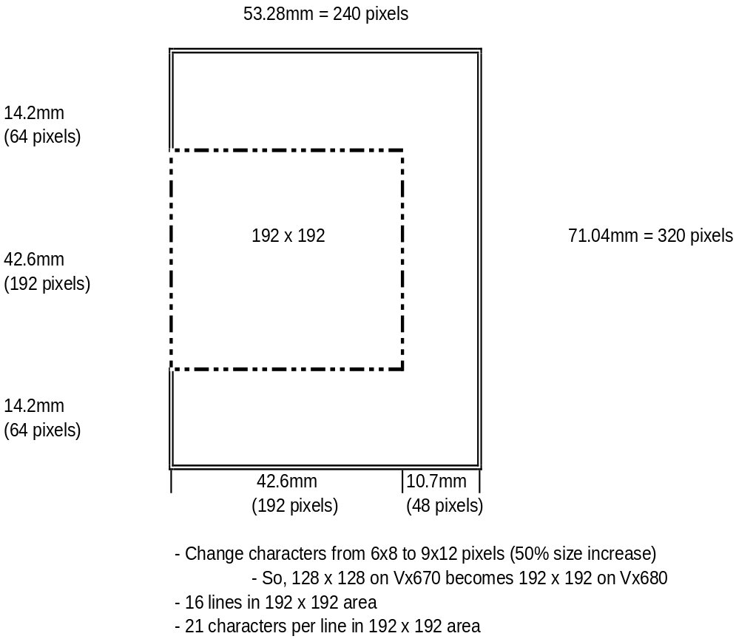
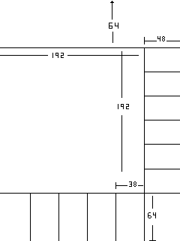
Application Interface
Vx680 – Proposed UI Template
For Bkwd Compat.
F0
F0
F1
F2
F3
F4
F5
alpha
VeriFone Confidential

Slide 18
New features in the working
Remote Key Loading
Integrated Contactless Reader for Vx680
F0
F1
F3
F4
F5
VeriFone Confidential

Slide 19
Remote Key Loading
What is Remote Key Loading?
  to securely inject symmetric acquirer keys, such as PIN encryption keys on to remote VeriFone terminals that are not physically present in a secure room
F0
F1
F3
F4
F5
VeriFone Confidential

Slide 20
Remote Key Loading
Why do we need RKL?
  Current key injection method is costly and inefficient
  Labor-intensive & prone to errors
  New PCI requirement demand annual rotation of keys
F0
F1
F3
F4
F5
VeriFone Confidential

Slide 21
Remote Key Loading
What is the benefits of Remote Key Loading?
  Streamline deployment process
  Secure key package can be electronically transported and injected into the terminals in store
  No need to swap out the terminals in use
F0
F1
F3
F4
F5
VeriFone Confidential

Slide 22
Remote Key Loading
Infrastructure Components
  A Key Generation Device (KGD)
  A Content Directory Server
  A Key Loading Device (KLD)
  A Customer HSM
F0
F1
F3
F4
F5
VeriFone Confidential

Slide 23
Remote Key Loading
Infrastructure Components
  Key Generation Device (KGD)
    create unique RSA Key pairs for every manufactured terminal based on its serial number
    Encrypting the keys for transport and publishing the certified Public keys to a content directory
F0
F1
F3
F4
F5
VeriFone Confidential

Slide 24
Remote Key Loading
Infrastructure Components
  Content Directory Server
    host the public key part of the RSA key pair for each serial number and a web application for search and retrieval of these public certificates. Additionally, the repository will act as a temporary staging area for encrypted RSA Key pairs for delivery to manufacturing and repair sites.
F0
F1
F3
F4
F5
VeriFone Confidential

Slide 25
Remote Key Loading
Infrastructure Components
  Key Loading Device (KLD)
    housed at every manufacturing site that will extract encrypted RSA key pairs from the secure FTP server, decrypt the encrypted RSA private key, establish a secure protocol with the newly assembled VeriFone terminal and inject the RSA key pair.
F0
F1
F3
F4
F5
VeriFone Confidential

Slide 26
Remote Key Loading
Infrastructure Components
  Customer HSM
    use public keys from the content directory to create device specific key packages using the TR-34 protocol.
F0
F1
F3
F4
F5
VeriFone Confidential

Slide 27
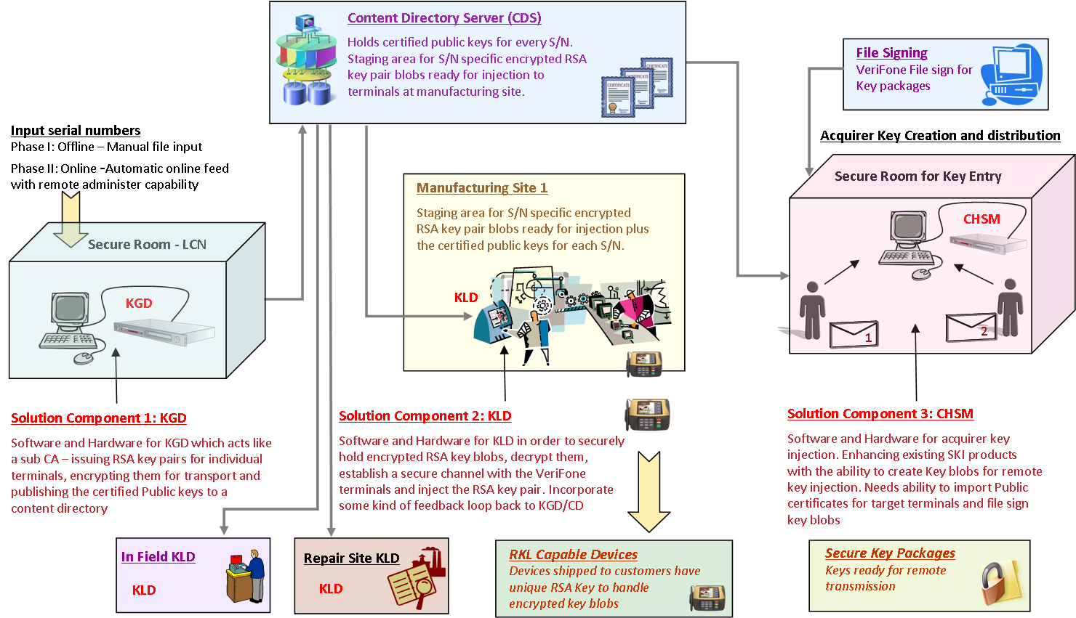
Remote Key Loading
F0
F1
F3
F4
F5
VeriFone Confidential

Slide 28
Integrated CTLS Reader
For Vx OS 11, the contactless reader (CTLS) device driver provides a low level (L1) interface to an integrated reader.
The Vx EOS 11 CTLS solution builds upon this functionality to give applications access to higher level functionality, including contactless EMV-like and magstripe-equivalent card handling.
The Vx EOS 11 CTLS support, with the underlying OS 11 contactless driver, can be compared to functionality provided by firmware on an external CTLS like the VivoPay 5000.
F0
F1
F3
F4
F5
VeriFone Confidential

Slide 29
Integrated CTLS Reader
Re-use the PP1000SE CTLS solution source code or design where applicable
The goal for the CTLS solution is to be compatible with single application environments, VMAC
multi-app environments, and other multi-app
environments.
F0
F1
F3
F4
F5
VeriFone Confidential

